Slide 1
Drupal
Santosh Kalwar
15-16.09.2022

Slide 2
Drupal Recap
Previously
You did well with group work on React + Drupal integration
We also looked into Drupal configurations: drush cex, cim
Today
Walkthrough of REST Export feature
Example of how this can be used
Progressively decoupled / headless
Custom Module: my_crud (CREATE, READ, UPDATE and DELETE)
Generate custom theme/module
Database commands
Group work

Slide 3
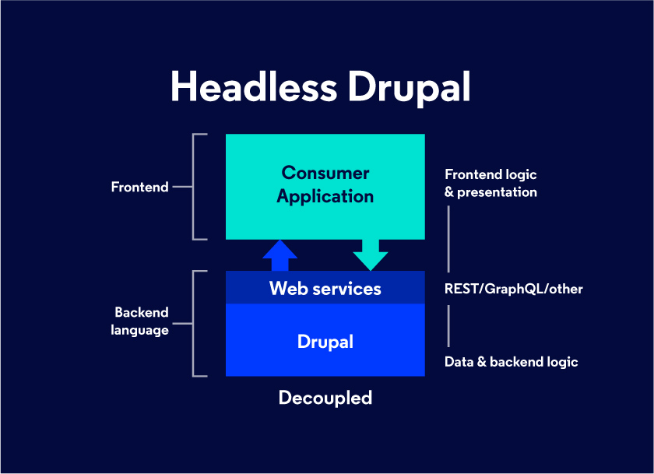
Recap: Progressively Decoupled
Simply put, in a headless CMS architecture, the front-end (consumers of content) of the CMS is detached from the back-end (provider of content). This not only enables your content to be delivered anywhere, it allows you to leverage latest Front-end technologies that offer unmatched user experiences.

Slide 4
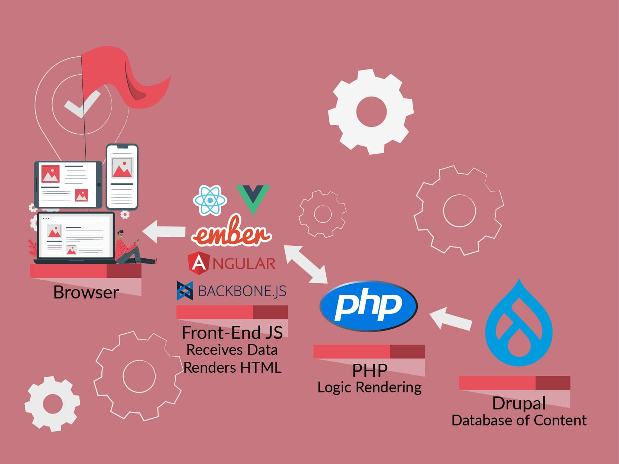
Recap: Headless Drupal
Technically speaking, a headless Drupal website sends out data in HTTP/JSON formats. A powerful front-end UI framework renders this data and delivers the web page.

Slide 5
Real-World Examples: Who uses Headless Drupal
Headless Drupal (or decoupled Drupal) is one such approach that is gaining much popularity because of its innovative ability to deliver outstanding digital experiences. Bigwigs like Weather.com, The Tonight Show, Great Wolf Resorts, Warner Music Group and many more, have taken the headless Drupal route offering their customers with interactive and unique front-end designs and fast-loading websites. The Tonight Show with Jimmy Fallon – uses Backbone.js and Node.js for the front-end
Weather[dot]com – uses Angular.js for the front-end
Warner Music Group – uses Angular.js for the front-end
https://www.drupal.org/case-study/the-weather-channel-weathercom

Slide 6
React + Drupal
There is a website which talks about React and Drupal
- Drupal 8
- a bit old content but still good to check
https://reactfordrupal.com/
https://drupalize.me/series/drupal-8-and-reactjs
You can browse through materials which are available there and listen to podcast about topics related to React and Drupal
https://www.lullabot.com/podcasts/drupalizeme-podcast/react-in-drupal-core
https://events.drupal.org/baltimore2017/sessions/look-possible-future-all-us-react-graphql-and-drupal

Slide 7
Recap: Walkthrough of REST export feature
Some of you already did this good work last week
Some misunderstood it so let me recap a bit
Why do you need this REST export feature
What is the benefit

Slide 8
Example: Progressively decoupled 1/4
Make sure you have a view with REST export feature
Go to Structure → Views
Your view must have path e.g. /node/rest or /api/rest
Preview and Save your view
Clone/fork the repo: https://github.com/kalwar/reactjs_drupal
Install dependencies

Slide 9
Example: Progressively decoupled 2/4
Change the URL of your Drupal website in config.js
Go to your drupal URL/session/token
Copy the token and save it in token file in REACT app
Run just like you will run any react app

Slide 10
Example: Progressively decoupled 3/4
You will see an error:
CORS error
Download CORS plugin for your browser, depending on which browser you are using:
Firefox:
https://addons.mozilla.org/en-US/firefox/addon/access-control-allow-origin/
Chrome:
https://chrome.google.com/webstore/detail/allow-cors-access-control/lhobafahddgcelffkeicbaginigeejlf

Slide 11
Example: Progressively decoupled 4/4
Enable CORS plugin ON
Refresh the REACT app once again
Debug: Do you see any data?
Would you be able to perform CREATE, READ, DELETE operations?
Video walkthrough (without voice) of these steps: https://unelmacloud.com/drive/s/wb0jcrknBokjh1Sdw58XlJFhuN04Ea
Video are tagged from number 1…4

Slide 12
Custom module: my_crud 1/2
CRUD Operations
https://en.wikipedia.org/wiki/Create,_read,_update_and_delete
Let us assume someone in the company asked you to create a CREATE, READ, UPDATE and DELETE operation using Drupal
How would you do it?

Slide 13
Custom module: my_crud 2/2
Let us use this module and see how it works
First download the module and install it using command line or GUI
Optional: Create a table called ”my_crud” inside phpMyAdmin
Optional: With following columns: id, name and age
Visit the route URL and check the application
Perform or do the CREATE, READ, EDIT and UPDATE operations
Navigation of these operations can be found from "module" yml file

Slide 14
Practice 01: Generate custom theme automatically
You can auto-generate custom module without writing single line of code in Drupal
Go to root of your project
lando drush generate theme
Theme name: my_generated_theme
Base theme: olivero
Enable the theme going into Appearance → theme

Slide 15
Practice 02: Generate custom module automatically
You can auto-generate custom module without writing single line of code in Drupal
Go to root of your project
lando drush generate module
Module name: my_generated_module
Controller: yes
Enable the module using either drush or GUI
Clear drush cache and visit the URL

Slide 16
Database commands
lando mysql
You can use all mysql commands inside lando interface
e.g. show databases; use database_Name, show tables;
select uid, uuid from users where 1;
lando db-export
lando db-import name_of_db_file.gz
Video walkthrough: https://unelmacloud.com/drive/s/yo2A5pAjJN99b6h914Mfd5frLOJis0
Regular database backup is always a good thing to do!
https://docs.lando.dev/guides/db-import.html
https://docs.lando.dev/guides/db-export.html

Slide 17
Group work
In this group work, your task is to select one of these 7 modules.​
​
Gin Admin Theme https://www.drupal.org/project/gin
Entity browser https://www.drupal.org/project/entity_browser
Next.js module https://www.drupal.org/project/next
Display Suite https://www.drupal.org/project/ds
Paragraphs module https://www.drupal.org/project/paragraphs
6. Charts module https://www.drupal.org/project/charts
7. Search API https://www.drupal.org/project/search_api
Note: Some of these are recommended by Dries Buytaert based on recent Portland DrupalCon 2022 conference

Slide 18
Group Presentation
Group presentation will start at 14:15​
Max 5-10 minutes per group​
Others will evaluate the presentation and provide feedback in itsLearning -> Group work results​
Ask questions and answers​
Note: Remember not to vote for your own group​
Upload the slides in Group work folder in itsLearning

Slide 19
Full day workshop: Druid Oy
Pasi Järnstedt and Laurie Lim Sam will join for workshop day on 16.09
Pasi will talk about
"what it means to be a developer" and
"how software development is done in company"
Laurie will show "demos on configuration management" and how Druid Oy utilizes peer review collaboration with code
You will do task based on these ideas and explorations
Questions and Answers

